Slide 1
Gains in Cohort Graduation Rates in Nevada
2011-2015

Slide 2
Introduction to the Problem
For the class of 2011, Nevada ranked the worst among states with a graduation rate of 62%
Washoe County School District (WCSD) is the second biggest school district in Nevada and covers much of Reno, Sparks, Incline Village, and surrounding areas in Northern Nevada.
Clark County School District (CCSD) is, by far, the biggest school district in Nevada and covers much of Las Vegas, Henderson, North Las Vegas, Boulder City, Mesquite, and surrounding areas in Southern Nevada.

Slide 3
Research Questions
How have the WCSD and CCSD graduation rates compared to the state of Nevada rates as a whole?
What has the trend in graduation rates been over the last five years, both statewide and in WCSD and CCSD?
Which groups of students have shown the biggest gains in graduation rates in WCSD and CCSD?
Which groups of students have shown the smallest gains in graduation rates in WCSD and CCSD?
Were there any community level variables that influenced graduation rates in WCSD and CCSD during this five year period?

Slide 4
Data
Graduation Rates: aggregated cohort graduation rates for Nevada, Georgia, Oregon, and Alaska
Unemployment Rates: Bureau of Labor Statistics
Crime Rates: city-data.com
Poverty Rates: U.S. Census Bureau

Slide 5
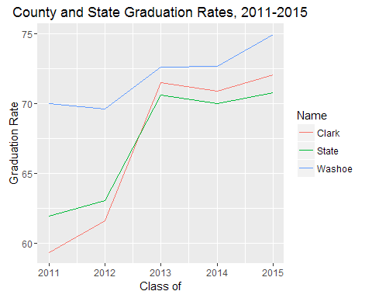
Data Analysis

Slide 6
WCSD has had the highest graduation rates overall when compared to CCSD and the State of Nevada as a whole
WCSD rates improved 4.95% between 2011 and 2015
CCSD graduation rates improved 12.73% between 2011 and 2015
These positive changes represent improvement at both the district and the state level.

Slide 7
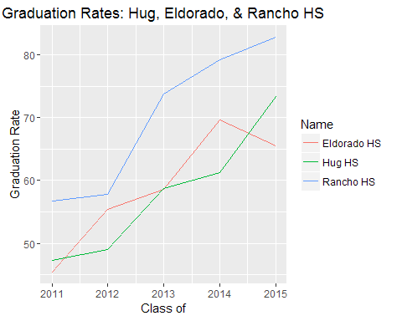

Slide 8
All three high schools showed huge increases in graduation rates from 2011 to 2015
Over this five year period, Hug High School graduation rates improved 26.10%, Eldorado High School graduation rates improved 20.09%, and Rancho High School graduation rates improved 26.16%
The overall trend is one of improvement for all three schools, although Eldorado had its highest graduation rates in 2014.

Slide 9
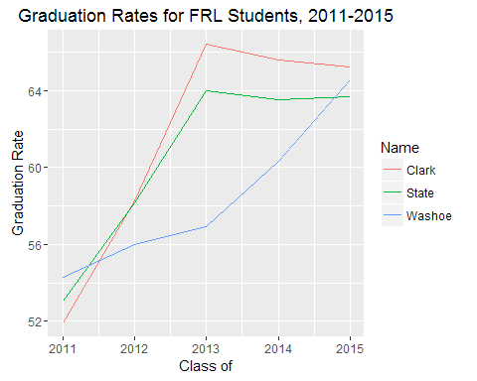
Special Populations

Slide 10
FRL students showed improvement over this five year time period
Graduation rates for FRL students in CCSD improved 13.3% to 65.23%
Graduation rates for WCSD improved 11.28% to 65.58%
Graduation rates for the State improved 10.6% to 63.68%

Slide 11
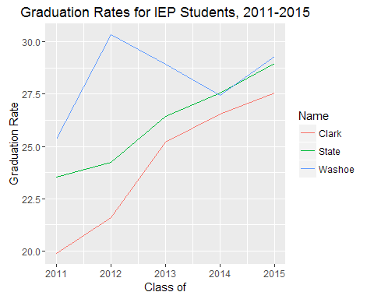

Slide 12
IEP students in CCSD showed the greatest five year improvement of 7.65%, followed by the State as a whole at 5.43%, and WCSD at 3.95%
WCSD had its highest graduation rates for IEP students in 2012 at 30.35%, while both the State and CCSD recorded their highest graduation rates for IEP students in 2015 with 28.97% and 27.55, respectively
The 2014-2015 State target for the percent of IEP students graduating from high school with a regular diploma is 83.76%. The actual graduation rates for IEP students fall well short of this target.

Slide 13
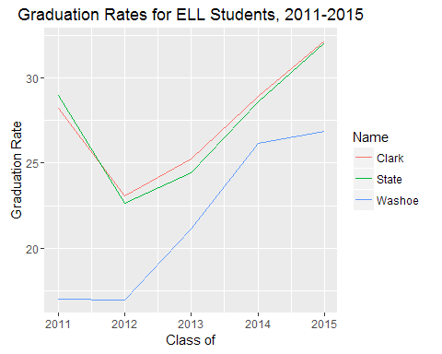

Slide 14
ELL students also showed modest gains in graduation rates between 2011 and 2015
WCSD ELL student graduation rates improved 9.83% to 26.85%
CCSD ELL student graduation rates improved 4% to 32.20%
State ELL graduation rates improved 3.09% to 32.05%.

Slide 15
Model Development
A linear regression model was fitted to the data to estimate the extent that unemployment rates, crime rates, and poverty rates were predictive of graduation rates in Washoe and Clark County School Districts between 2011 and 2015
The crime rate and poverty rate variables were deleted from the model because they were not found to be significantly related to graduation rates.
The final bivariate regression model estimates the effect of unemployment rates on graduation rates in Washoe and Clark counties.

Slide 16
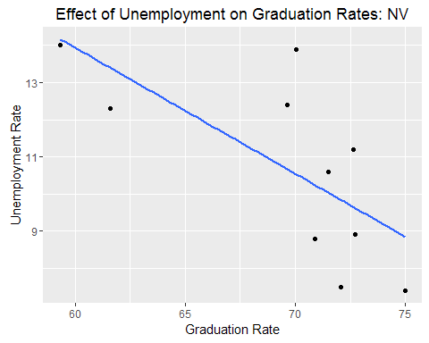

Slide 17
As expected, graduation rates increased as unemployment rates decreased
This model explains 48% of the variance in the graduation rates in Washoe and Clark Counties between 2011 and 2015 (R-squared=.48)
Nearly half of the gains in graduation rates during this time can be attributed to decreases in the unemployment rates.

Slide 18
In order to assess whether this relationship between graduation rates and unemployment rates would hold true in similar communities, bivariate regression models were estimated for urban areas in other low performing states
The states with the lowest graduation rates in 2011 were Nevada, New Mexico, Georgia, Oregon, and Alaska
Graduation and unemployment rate data were gathered for counties (or boroughs) who had populations of at least 225,000 people
New Mexico was excluded from the analysis because it has many school districts per county and some cities and school districts straddle county lines
Regression models were estimated for each of the remaining states separately

Slide 19
Effects of Unemployment Rates on Graduation Rates in Under Performing States
State | Unemployment.Rate.Coefficient | p.value | R.squared
Nevada | -1.42 | 0.03 | 0.48
Georgia | -3.09 | 0.00 | 0.47
Oregon | -1.52 | 0.00 | 0.31
Alaska | -4.40 | 0.15 | 0.55

Slide 20
In each model, graduation rates increased as unemployment rates decreased
This relationship was significant across all of the models, except for the model for Alaska where there likely was a loss of power due to small sample size.

Slide 21
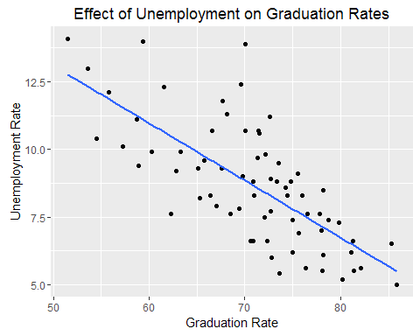

Slide 22
A final bivariate regression model was estimated with data from all four of the underperforming states together
Again, a strong relationship between graduation rates and unemployment rates was evident
This model explains 52% of the variance in the graduation rates in the urban areas of the underperforming states between 2011 and 2015 (R-squared=.52).

Slide 23
Conclusions
Graduation rates have improved at both WCSD and CCSD and at the State level between 2011 and 2015
Some schools, such as Hug High School in WCSD, and Eldorado and Rancho High Schools in CCSD, have shown large improvements in graduation rates
Special populations of students have shown gains over this five year period, but are still lagging well behind when compared to the general student population

Slide 24
Conclusions (cont.)
In Washoe and Clark counties in Nevada, high unemployment rates appear to have put stressors on families that resulted in decreased graduation rates
The current research suggests that unemployment rates can effect graduation rates, at least in more urban communities where the effectiveness of schools might be especially vulnerable to environmental influences because they are already underperforming

Slide 25
Recommendations
Students who are economically disadvantaged, students with disabilities, and students who are English language learners represent the biggest opportunities for growth in the future
The results of the current research make clear that State goals for future graduation rates are dependent not only on changes at the district and school levels, but also on community level factors
Specifically, economic development in the urban areas of Nevada needs to be a major focus in order to keep unemployment rates lower, if graduation rates are to continue to rise.

